Slide 1

BAN 130 FINAL PROJECT Flight Delay Prediction
Group 01 Members:
Srijith Leelakrishnan
Luxmikant Mukkawar
Pravinda Daniel Anthony
Henadera A Pulathis Maduranga Perera

Slide 2
Introduction
The Aviation industry expands rapidly with annual increases in the use of Airplanes as a mode of transport.
On time performance or flight punctuality is a main KPI in the air transportation industry
A delay goes much further than just being an inconvenience to the passengers. There are many costs associated with delays, including accumulated delays of onward and connecting flights.
The number of flights between various locations has risen as a result of this.
The project will determine the variance in traffic between different airports and flight carriers on each day of the week and determine the most rushed day of the week.

Slide 3
Description of Data set
Variable Name | Description
CRS_DEP_TIME | Scheduled time of Departure
CARRIER | Airline Code (2 letter code). Also known as ‘callsign’
DEP_TIME | Actual time of Departure
DEST | Destination Airport Codes (EWR, JFK, LGA)
DISTANCE | Flight Distance
FL_DATE | Date of the flight
FL_NUM | Flight number
ORIGIN | Departure Airport Codes (BWI, DCA, IAD)
Weather | 0 - Favorable Weather | 1 - Unfavorable Weather
DAY_WEEK | Day of the week with 1-Monday, 2-Tuesday,…., 7-Sunday
DAY_OF_MONTH | Day of the month (from 1 to 31)
TAIL_NUM | Legal name of the aircraft. It is unique to each aircraft
Flight Status | Delay Status of the flight (Ontime. Delayed)
FlightDelays.csv
Contains information on all commercial flights that departed the Washington, D.C., area and arrived in New York during January 2004

Slide 4
Objective
To accurately predict whether a flight will be delayed
- Predict which carrier to take on which day of the week to have a higher probability of avoiding a delay

Slide 5
Data Preparation
Step 1 – Cleaning the data
Actions to remove missing values or values with error is performed using SAS functions and Procedures
Data cleaning process will ensure:
Errors can be checked and corrected
Missing values can be checked and treated
One or more derived variables can be created
Combined values in one for a categorical variable

Slide 6
Step 2 – Calculations to identify patterns in delay between airports
-Analyzing Average daily delay departures at each airport
- Average Daily Delay for all the airports of origin
- Average number of daily flights per airline carrier
Step 3 – Identify the relationship between variables
- Plot histograms for each of the quantitative variables and identify which variable has the largest variabilities
- Pivot tables to summarize data and highlight facts about the dataset
Step 4 – Data Reduction
- Create new dataset called ‘FlightDelays_Reduced’ in the ‘Predict’ library and assign dataset ‘FormattedData’.
Step 5 – Data Conversion – Non-numerical data is converted to numerical

Slide 7
Step 3 – Identify the relationship between variables
- Plot histograms for each of the quantitative variables and identify which variable has the largest variabilities
- Pivot tables to summarize data and highlight facts about the dataset
Four pairs of variables were selected as shown below:
ORIGIN*DEST
FLIGHT_STATUS*DAY_WEEK
CARRIER*DAY_WEEK
CARRIER*FLIGHT_STATUS

Slide 8
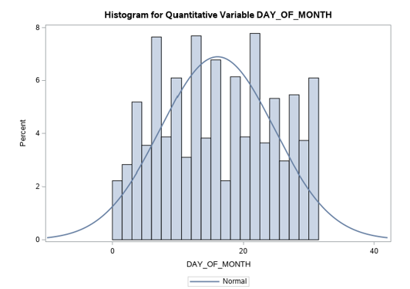
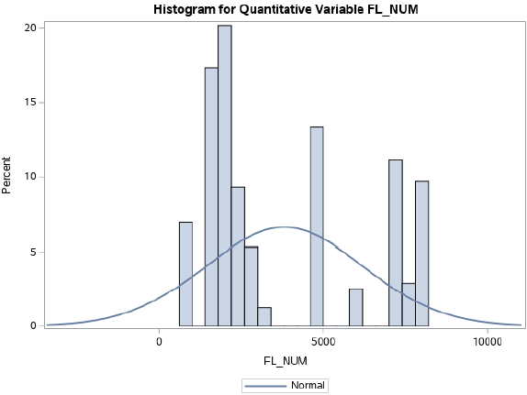
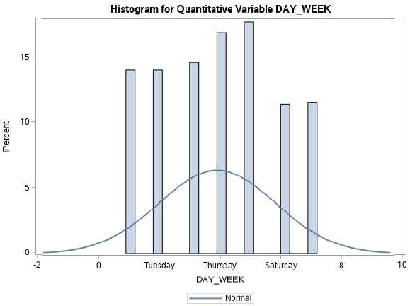
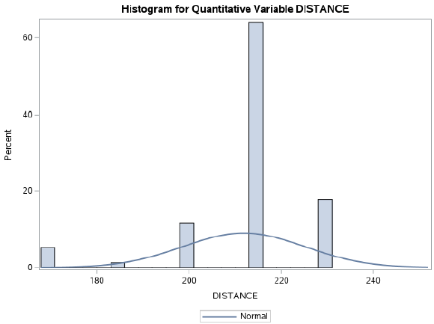
Histograms

Slide 9
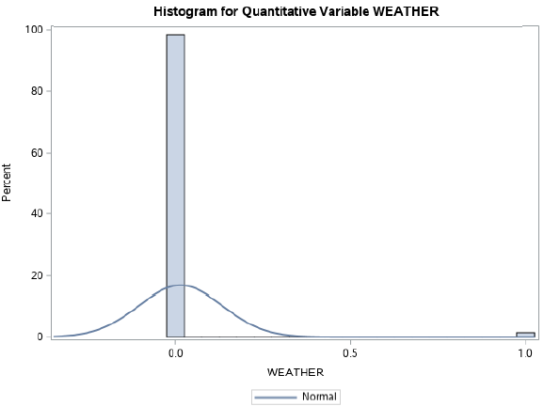
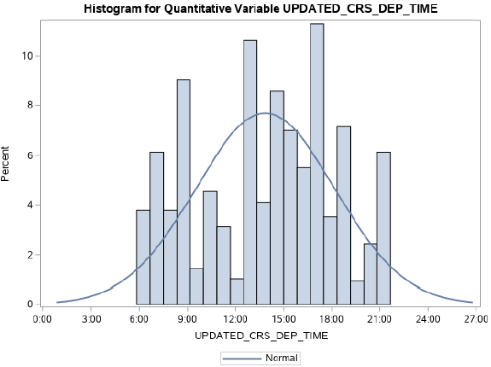
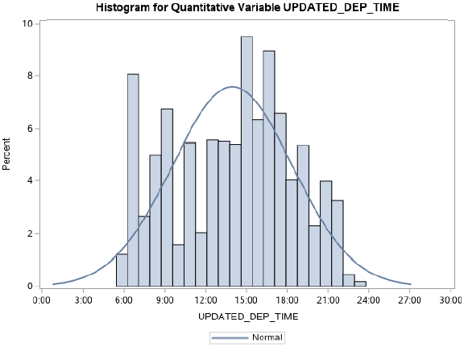

Slide 10
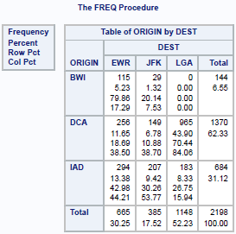
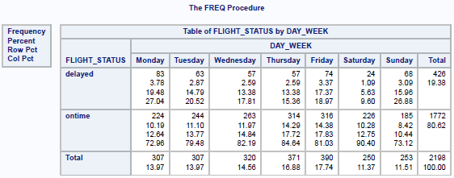
Pivot tables

Slide 11

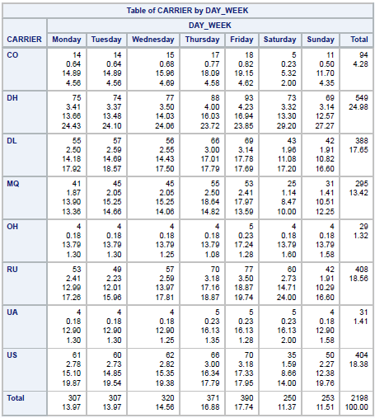
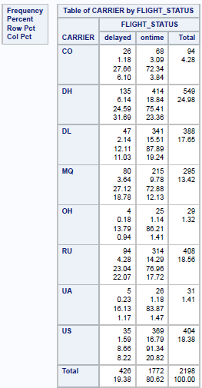

Slide 12
Prediction
Project was to provide a passenger with adequate information to decide which days of the week and which airlines to choose if they are to avoid flight delays
-Analyzing Average daily delay departures at each airport
- Average Daily Delay for all the airports of origin
- Average number of daily flights per airline carrier

Slide 13
Prediction
- Using proc sql, a table was created to examine the average daily delays per carrier. The table was grouped using variables – Carrier, Day_Week and Delay_in_mins.
- As a further step, sgplot statement was used to plot a scatter graph to determine average delays on each of the seven days of the week.
- a report was generated to determine the average delay per each day of the week. This was done using proc report together with ‘define’ and ‘analysis mean’ functions

Slide 14
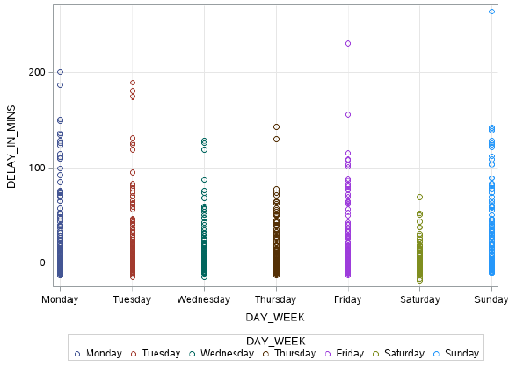
Predictions- Days of the week
To summarize the prediction; It is best to avoid travel on Sundays and preferably Mondays as well.
Wednesday and Tuesdays are the best days to travel

Slide 15
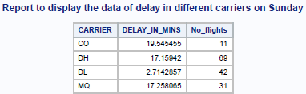
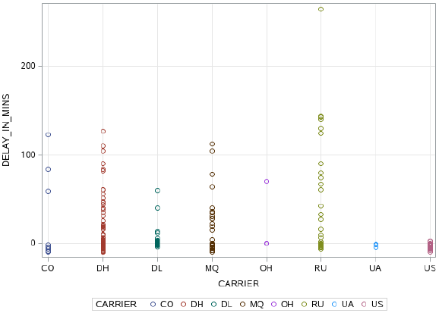

Predictions- Best carrier
However, if a passenger must travel on a Sunday, it is best to fly on US carrier (US Airways).

Slide 16
Challenges
Insufficient data
Very few records
Lack of information on weather
Weather plays a major role in determining if the flight would be delayed or not

Slide 17
Improvements
Based on the conclusion detailed in our report the following can be further developed:
Predictions of flight statuses based on varying weather conditions.
Provide accurate arrival time for better analysis and prediction of the estimated arrival time.

Slide 18
Thank You!!!!

